Slide 1

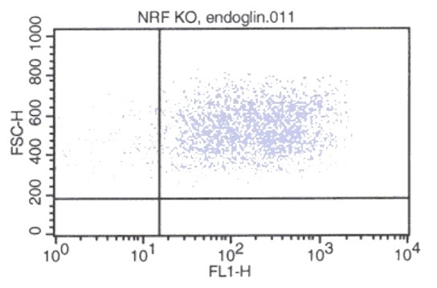
ReliaTech GmbH
Rat anti-mouse CD105/Endoglin
(Cat #103-M60)
Fig. 1: FACS analysis with NRF KO cells. As secondary antibody anti-rat IgG-FITC was used.
http://www.reliatech.de / orders@reliatech.de

